Slide 1
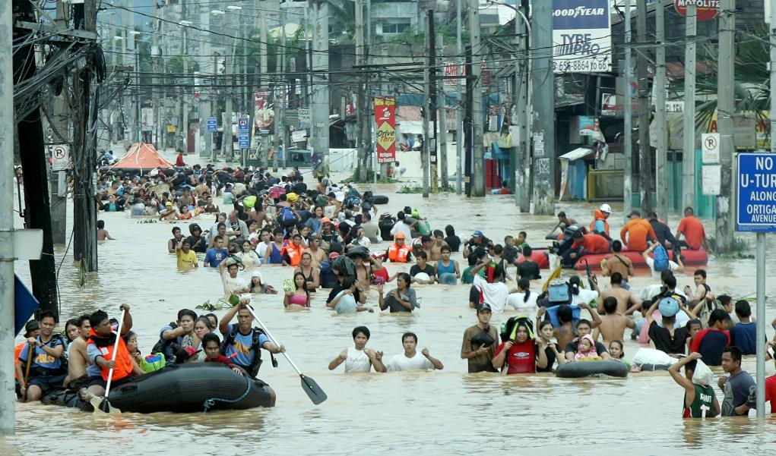


Creating Resilient and Livable Cities
Pacific Cities Sustainability Initiative
2nd Annual Forum - Manila, Philippines - March 11-13, 2014
Dr. Sujata S. Govada

Slide 2
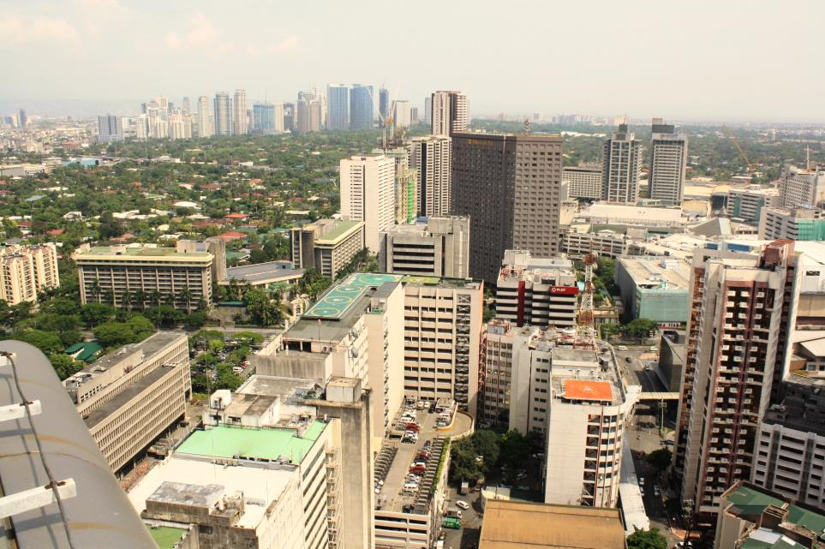
Ten Principles for
Sustainable Development of Metro Manila’s New Urban Core

Slide 3
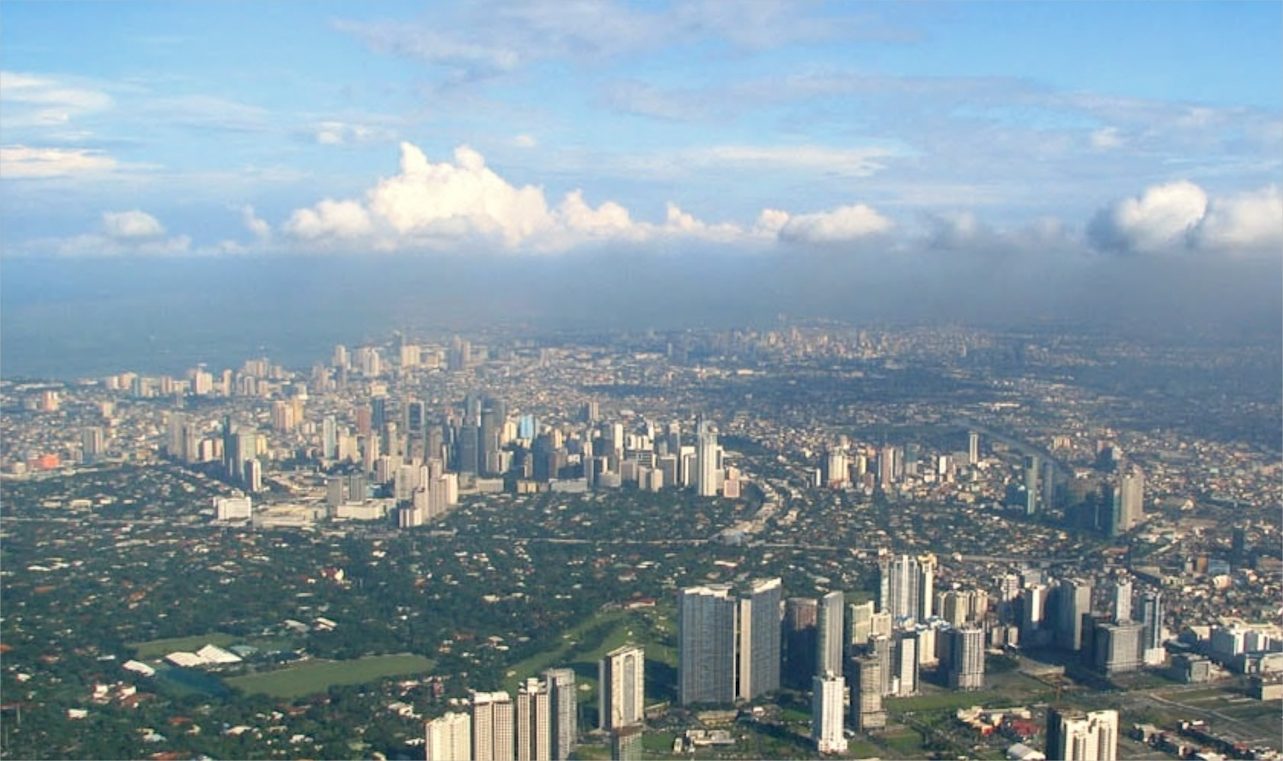
The Ten Principles Methodology
A collaborative and multi-stakeholder approach.
- Background Research
- Multi-stakeholder Interviews and Workshop
Focus Group Meetings and Discussions
Benchmarking Regional and International Examples
Project Steering Committee Meetings and Discussions
- Develop and Present Draft Principles
- Release of ULI 10 Principles for Metro Manila NUC

Slide 4
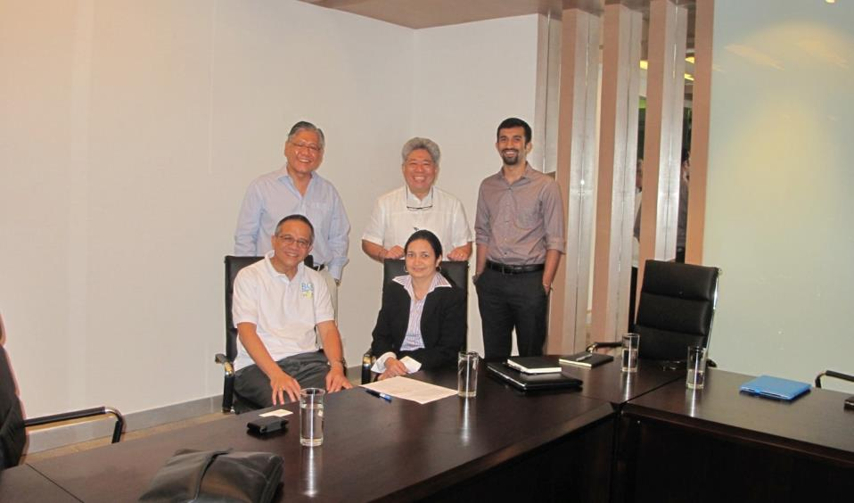
The Ten Principles Process
Principles to help guide a transforming NUC.
Multi-stakeholder Interviews
In order to gain a better understanding of Metro Manila’s critical urban issues the project team set out on several stakeholder interviews from various developers, recreation club presidents to barangay officers, government agencies and NGOs.

Slide 5
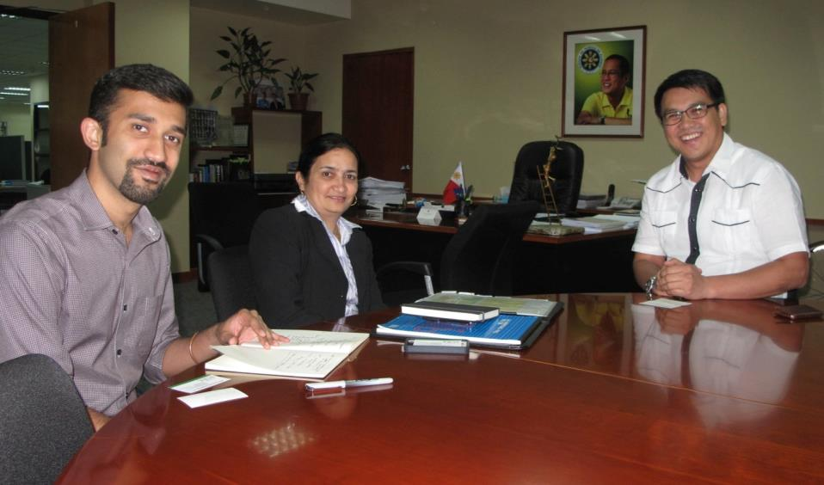
The Ten Principles Process
Principles to help guide a transforming NUC.

Slide 6
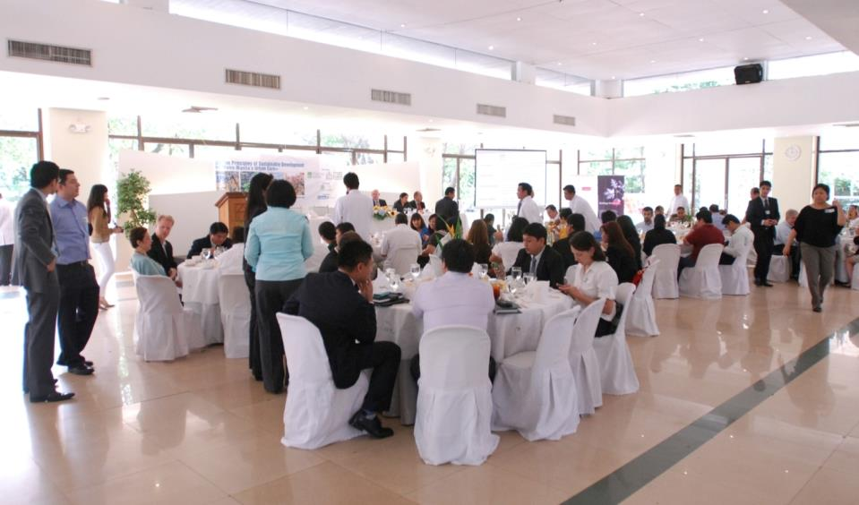
The Ten Principles Process
Principles to help guide a transforming NUC.
Ten Principles Kick-off Luncheon and Workshop
Following the stakeholder interviews, the Kick-off Luncheon and workshop for the Ten Principles study of the ULI’s Philippines chapter. The workshop had a great turnout and was supported by many public, private sector organizations and NGOs.

Slide 7
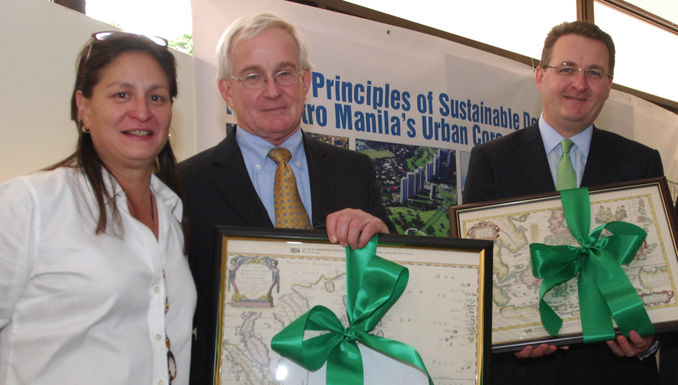
The Ten Principles Process
Principles to help guide a transforming NUC.

Slide 8
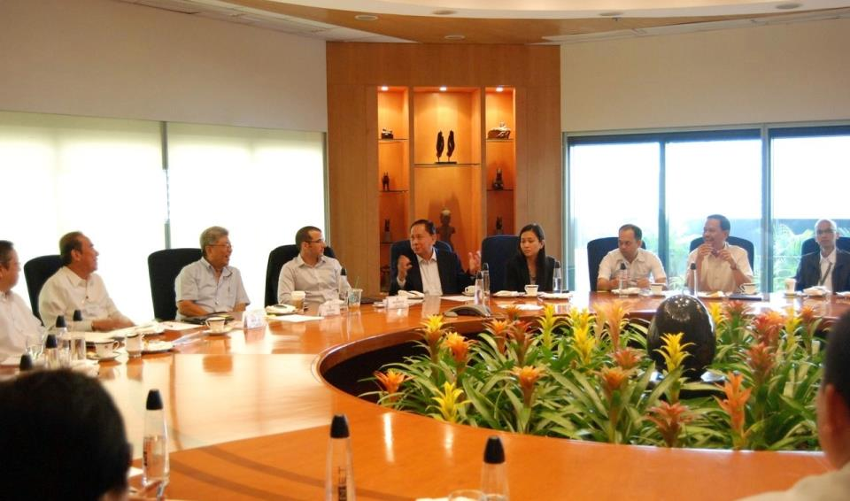
The Ten Principles Process
Principles to help guide a transforming NUC.
Ten Principles Focus Group Sessions
As a follow up to the Multi-stakeholder Workshop, targeted Focus Group sessions were held to start narrowing the conversation down to the key urban issues in Metro Manila as well potential principles for a more livable and walkable Metro Manila’s New Urban Core.

Slide 9
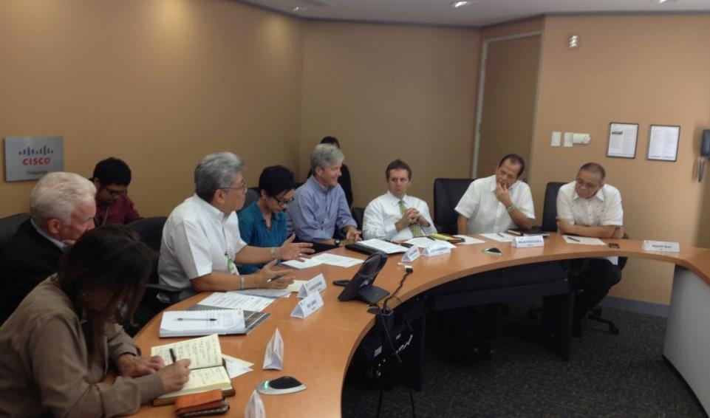
The Ten Principles Process
Principles to help guide a transforming NUC.
Ten Principles Project Steering Committee Meetings
Similar to the Hong Kong study, a Project Steering Committee was set up to guide the study based on the information and findings gathered from the interviews, workshop, focus group sessions as well as independent research and help formulate the principles.

Slide 10
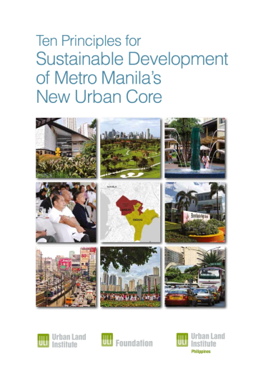
The Ten Principles
After several months of discussions, consolidating findings and drafting the ten principles, the report is now ready to share with the world.
A special thanks goes to ULI and its staff as well as Charlie, Jo, Ces and Nicole from the ULI Philippines office. This report would not have been possible without their support and continued efforts!

Slide 11
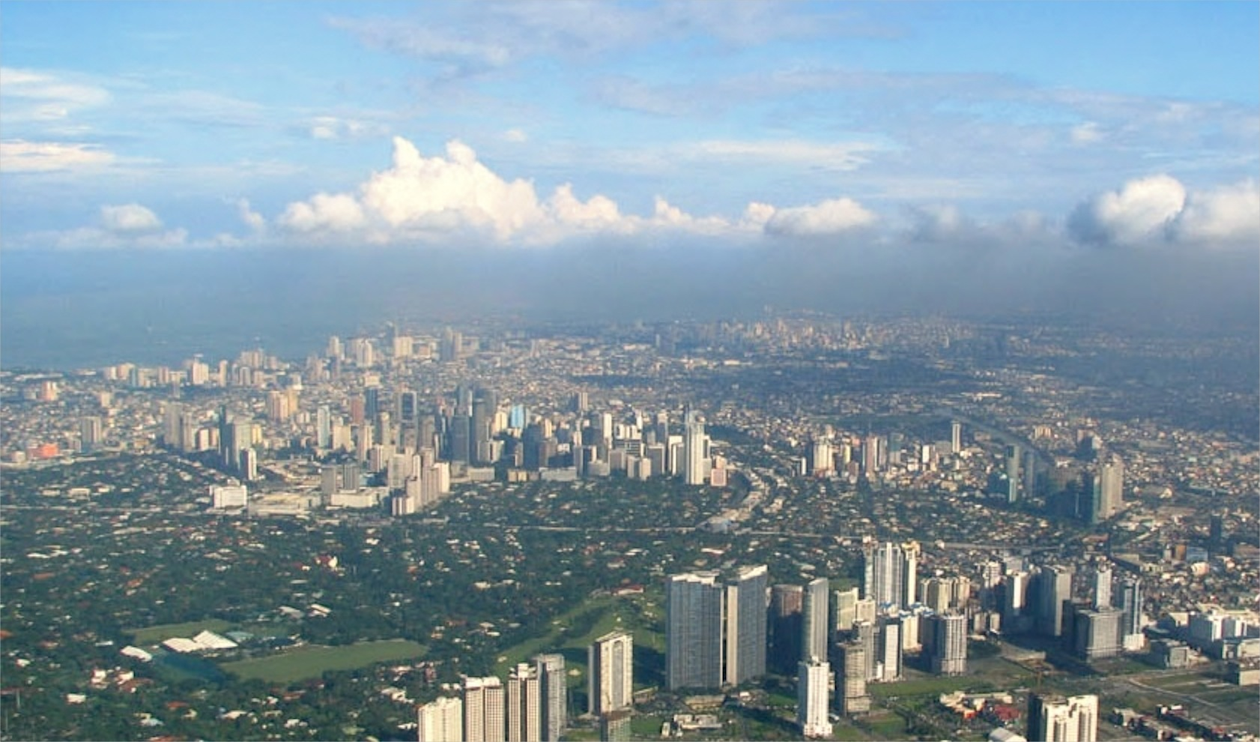
1. Create One Metro Manila
A Common Goal and Vision.
Most cities that have transformed their identity, do so with a “City Champion.”
Oversight of land use planning is difficult in current political climate.
Location branding is key in attracting new business and tourists.
Perhaps it is best to think big but start small—starting with the NUC.
Who will be the champion for the NUC?
Who can work with the various stakeholders and come up with a common goal and vision for the NUC?

Slide 12
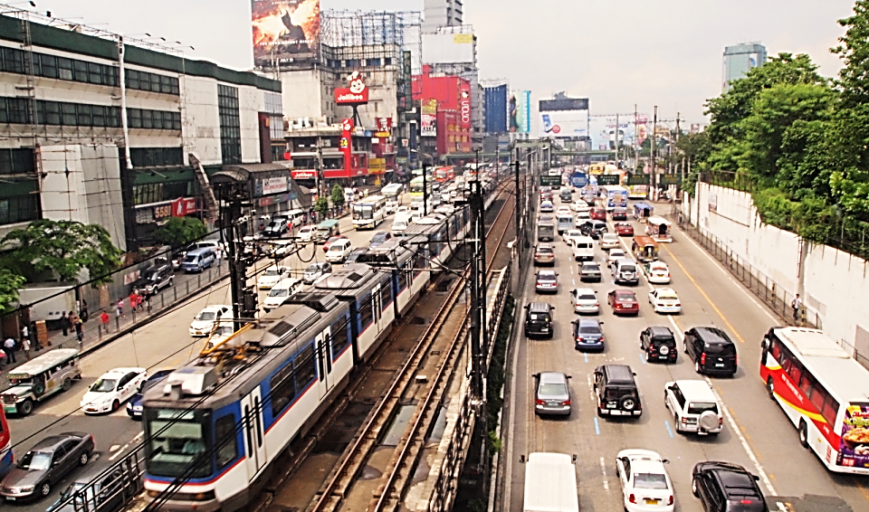
2. Improve Urban Mobility
Integrated Transport and Infrastructure.
Traffic problems in Metro Manila affect “its more than 10 million residents, with vehicles traveling on average no faster than 15 kmh on a weekday along Epifanio de los Santos Avenue [EDSA]”
Too many private cars, a disorganized bus transport system, and jeepneys are to blame.
Poor discipline and driver behavior, which often result in illegal parking, lane shifting, long waits, bribes, and other issues, further exacerbate the situation.
It is not enough to look at areas of Metro Manila such as Makati CBD and BGC in isolation. Urban problems cannot be solved independently within each district.
There are several private sector initiatives taking place, but need more effort from the public sector.

Slide 13
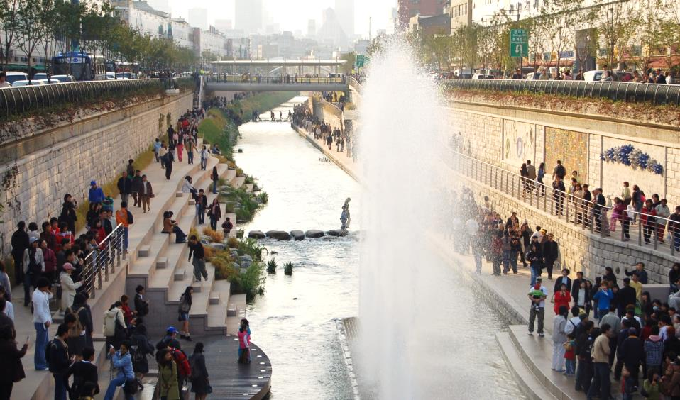
3. Make Beautiful Places
Business Improvement Districts and High-Quality Public Space
Unique and attractive open and accessible places, whether public or private, are what give cities their flavor and character. They are the lungs of cities.
Metro Manila’s pedestrian network is not well defined to facilitate walking. Vehicle circulation rather than pedestrian needs is still given priority, making it unsafe.
Metro Manila can consolidate successful efforts by MaCEA and BGCEA and learn from Business Improvement Districts (BIDs) elsewhere.
Place making, a growing focus of urban planning and design, is a multi- faceted approach that centers on both public and private open space while remaining contextually sensitive to the surrounding environment and people.

Slide 14
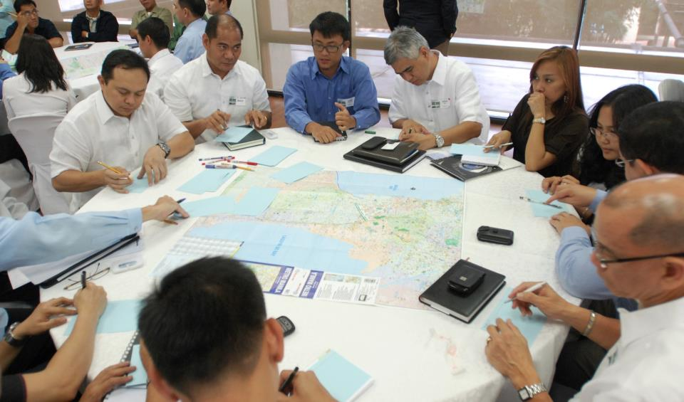
4. Work Together
Collaboration and Partnerships
The Philippines with its expanding economy and a growing population, has a great opportunity to move forward. Metro Manila needs to find ways to address its critical urban problems such as transport and infrastructure despite lack of funding.
Public/private partnerships are a key tool for financing public projects in the Philippines.
A number of successful PPP projects exist in Metro Manila, which bodes well for future private investments.
No sustained dialogue exists between the public and private sectors to ensure that the PPP process is streamlined.
Critical urban issues cannot be resolved through work conducted independently at the site-specific or district level.

Slide 15
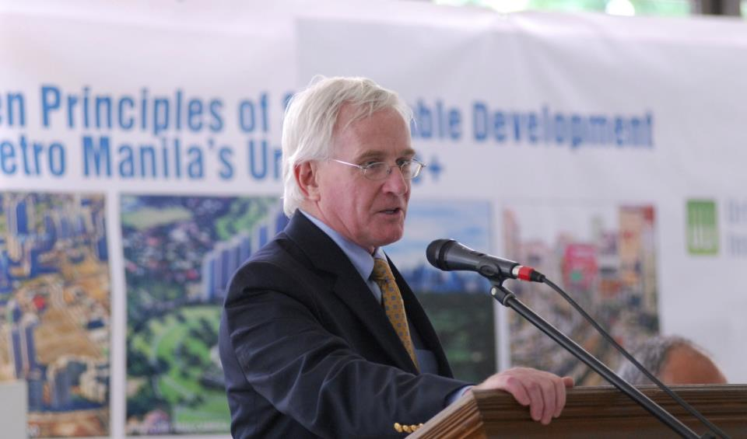
5. Establish Good Governance
A Streamlined Regulatory Framework and Effective Development Control
A committed city authority is essential in creating an efficient, coordinated, and harmonious environment for living, working, and playing.
Uneven distribution of financial resources between cities like Makati and Taguig is an issue that needs to be resolved, with a more streamlined regulatory framework and effective development control.
Strong leadership and good governance will help Metro Manila formulate and implement a master plan, as well as resolve of land use and transport planning matters.
As MMDA becomes stronger and more powerful, the authority will be able to carry out planning and other duties mandated more effectively.

Slide 16
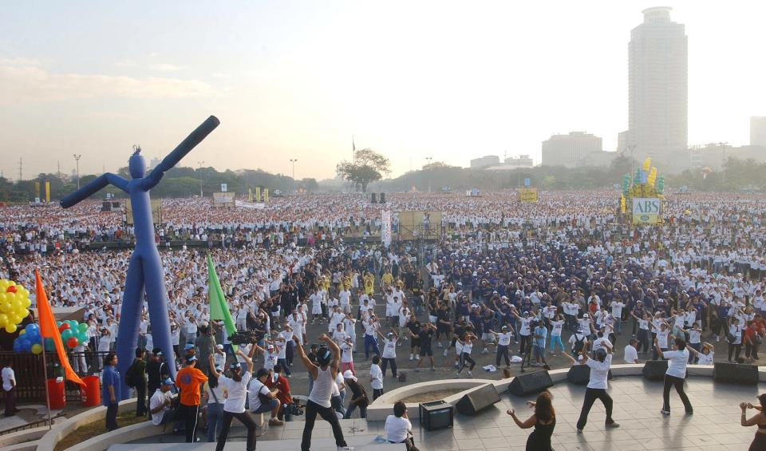
6. Engage Everyone
An Inclusive, Participatory, and Transparent Process
It takes time to develop public participation to the extent that community members trust that their input is valued and will play a role in public planning.
It is imperative that Metro Manila take a participatory and inclusive approach to community planning and development.
MMDA’s Metro Manila Greenprint 2030 planning strategy study, begun in 2012, is a step in the right direction, engaging key stakeholders in order to boost its regional competitiveness.
ULI also invited various stakeholders from various backgrounds to participate in formulating the Ten Principles for Sustainable Development of Metro Manila’s New Urban Core.

Slide 17
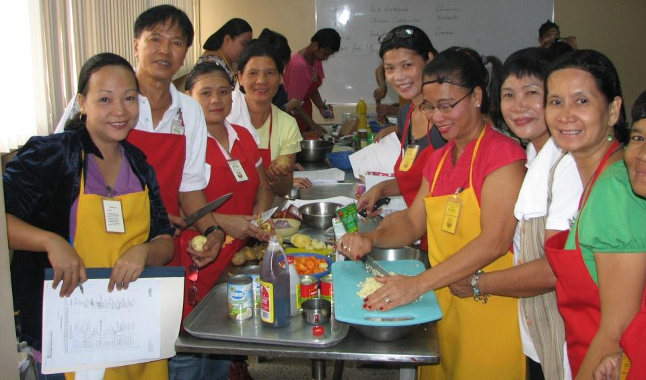
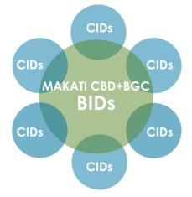
7. Empower People
Community Improvement Districts to Enhance Education, Awareness, and Employment Opportunities
Education increases the innovative capacity of an economy and facilitates the diffusion, adoption, and adaption of new ideas. It is especially important in a rapidly evolving economic environment.
As is the case in other developing countries, simply creating job opportunities is not enough to help the poor improve their lives.
Community improvement districts (CIDs) should be created on the periphery of Makati CBD and BGC, where many of the poor in the Makati and Taguig LGUs reside.
The private sector and NGOs can undertake initiatives within these CIDs to educate and empower the poor by coming up with innovative ways to bring opportunities to them.

Slide 18

8. Be Prepared
Disaster Preparedness and Resilience
According to the World Health Organization, 1.15 million Filipinos were affected by floods, storms, and earthquakes in 2011, surpassing the 368,820 Japanese affected by the tsunami that same year.
Unless a plan is implemented to improve its resilience, Metro Manila becomes more susceptible to irreversible damage with the coming of each typhoon or flood.
The 2010 formation of the Marikina Watershed Environs Integrated Resource Development Alliance by the cities of Pasig, Marikina, and Antipolo and the municipalities of Cainta, San Mateo, and Rodriguez—also known as the Alliance of Six.
Several initiatives are underway to improve infrastructure, including a new flood control master plan, MMDA’s Greenprint 2030 study, creation of more evacuation centers, and infrastructure upgrades.
Communities and residential villages have also been working together to form their own emergency-response teams.

Slide 19
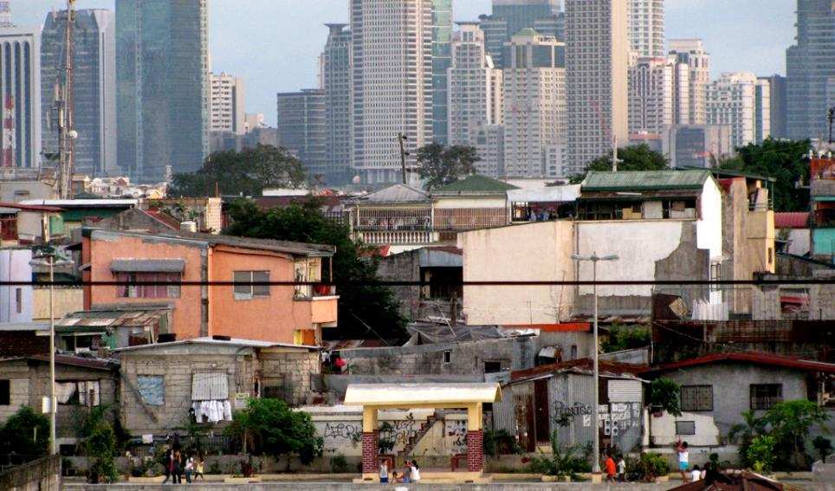
9. Restore Human Dignity
Affordable Housing Policy and Delivery
A good, affordable quality of life for all is essential in creating sustainable communities in fast-growing Metro Manila.
The solution for many new immigrants is to live in the slums of Metro Manila, which are dispersed, usually plagued by high unemployment and high poverty rates.
Some local initiatives have taken up these problems, such as the recently launched National Slum Upgrading Strategy (NSUS).
The NGO Gawad Kalinga promotes the principles of mutual respect for all community stakeholders, as well as a sustainable livelihood for members of a multiethnic society.

Slide 20
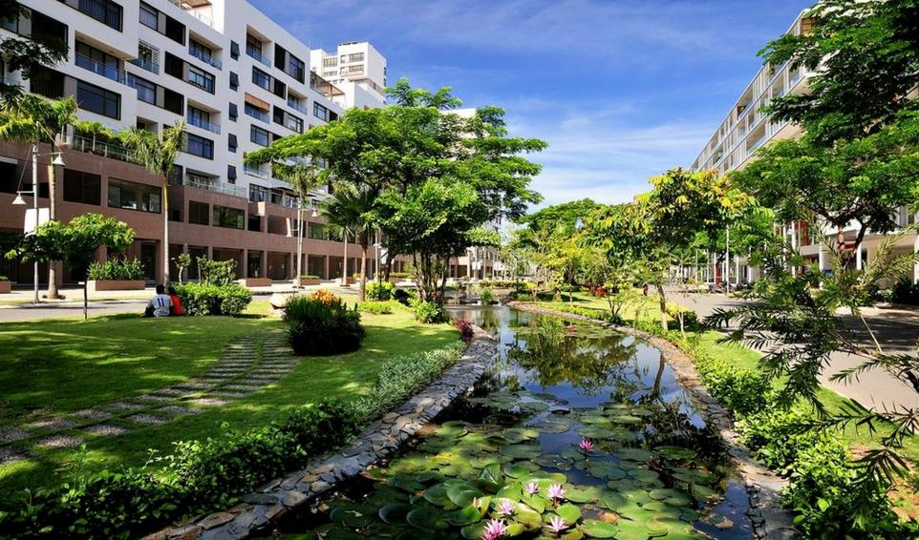
10. Go Beyond Smart Communities
More Livable and Sustainable Communities
Smart cities and sustainability is a global trend targeted at using technology and enabling continued development of human society, aiming to balance social and economic growth while reducing consumption of natural resources.
Buildings and transportation account for 70 percent of green-house gas emissions. Planning should start at the regional scale to create livable communities.
Neighborhoods that offer a high quality of life and maintain long-term value for residents should be located in convenient areas.
Education and awareness programs are also needed to ensure that people from all walks of life do their part in promoting smart and sustainable communities.

Slide 21
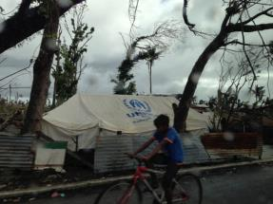
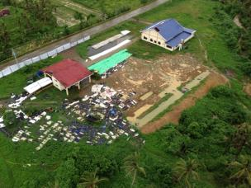
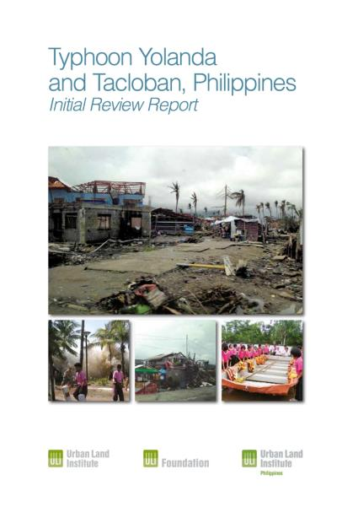
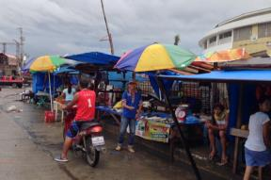
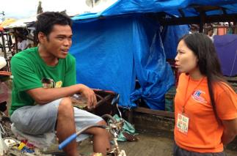
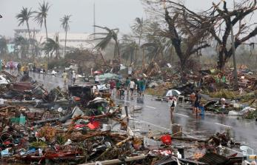
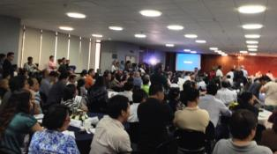

Slide 22
PRELIMINARY OBSERVATIONS
Immediate to Short-term
Addressing Urgent Needs:
  Food, temporary shelter, medical care, livelihoods, local needs, to ensure that they can recover and rebuild their lives to be much better.
  Need for medical supplies and provision of medical care with local and international input.
Clearing of debris and issues with dead bodies:
  Identify the dead bodies, clearing debris, repairing buildings such as schools and hospitals, so that people can be taken care of and life can get back to normal as soon as possible.
Education and creating awareness:
  Education and awareness to ensure people know how to act and what help and assistance is available. Also how people are coping with the situation, this will help empower people as well.
  Communication is key so people are more aware of how their needs are being addressed. This will need to be done at local, regional, national and international level as well.

Slide 23
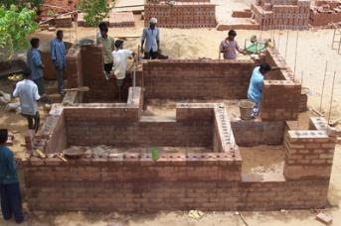
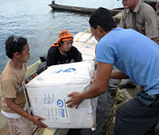
PRELIMINARY OBSERVATIONS
Immediate to Short-term
Supporting livelihoods and business:
  Assistance to people and businesses are being delivered so they can begin to rebuild their lives and businesses.
  Financial and other assistance to LGUs so they can better manage the rebuilding and rehabilitation efforts.
  Getting the private sector, NGOs involved in the process is good as well, rather than relying entirely on the public sector.

Slide 24

PRELIMINARY OBSERVATIONS
Short to Mid-term
Addressing Basic Needs:
  Address basic needs for shelter, education, health and business so that life can get back to normal and people can regain their livelihoods.
  There is still widespread need for electricity and clean water. Running water has been restored in some of the more central areas of Tacloban, but other areas of Leyte and Samar islands are still without water. Water purification is another important aspect, looking to get more of the innovative equipment donated at present, maybe good to address the short to mid term needs.

Slide 25
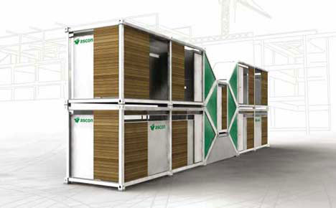
PRELIMINARY OBSERVATIONS
  Well-planned Temporary Shelter:
  Temporary shelter should be planned well, with some planning principles already in mind. They should be built and located in a way that follows certain planning principles and conducive for community building and livability. From studying past disasters, it seems temporary shelter is never as temporary as is first envisioned.

Slide 26
PRELIMINARY OBSERVATIONS
Mid to Long-term
Strategic Vision and Framework:
  Strategic vision and framework in place for the long-term planning and development of a proper master plan for Tacloban
  Deciding where to build will be a crucial part of the rebuilding strategy. Relocation will cause some conflict, especially for those who depend on the coast for their livelihoods. Innovative alternatives must be considered to address these issues.
Relocation and Displacement:
  Displacement and land disputes must be properly addressed.
  In case of relocation of vulnerable populations, the terms of resettlement should ensure basic amenities and sustainability livelihoods as entitlements.
  Forced migration/relocation should be avoided, but as the Philippines is often subject to typhoons, this must be considered in relocation strategies.

Slide 27

PRELIMINARY OBSERVATIONS
Mid to Long-term
Awareness:
  An early disaster awareness network and reinforced communication network
  Disaster awareness education throughout schooling and training programmes, to increase community resilience
Coastal Protection:
  Improve coastal defense through coastal conservation, eg. Coral reefs
  Sand nourishment could benefit coastal protection as well
Spatial Quality Assessment:
  Assess ‘spatial quality’ of different parts of the coast and implement barriers accordingly. Also to counteract the ‘funneling’ effect of storm surges.

Slide 28
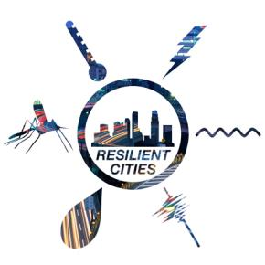
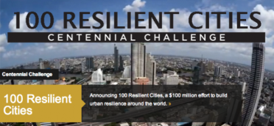
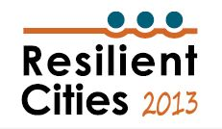
RESILIENT & LIVABLE CITIES
Urban resilience: “capability to prepare for, respond to, and recover from significant multi-hazard threats with minimum damage to public safety and health, the economy, and security“ (Wilbanks, T. 2007)
Resilience is a forward looking approach. It goes beyond disaster recovery, risk mitigation and, instead, looks to enhance capacity.
Increasing emphasis on resilient and livable cities:

Slide 29
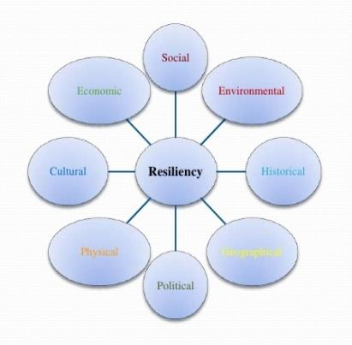
RESILIENT & LIVABLE CITIES
  Many different types of (urban) resilience: (World Bank, 2012)
  Social/Community resilience: refers to the ability of a group of citizens to adapt, and a sense of attachment to a place.
  Infrastructural/Physical resilience: refers to the vulnerability of built structures.
  Financial/Economic resilience: refers to a measure of a community’s economic diversity and overall employment.
  Environmental/Ecological resilience: refers to the measure of the environment/ecosystem’s ability to absorb changes and still exist.

Slide 30
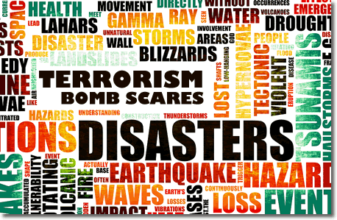
NATURAL DISASTER RESILIENCY
Natural Disaster Resiliency
  The ability of a system, community or society exposed to hazards to resist, absorb, accommodate and recover from the effects of a hazard in a timely and efficient manner. (EAP Handbook).
  Addressing natural disaster risk and building up capacity.
Risk and Vulnerability: All places are susceptible to natural disasters, some more than others.
Urban disaster resilience consists of various types of resilience: Eg. Infrastructural, economic, institutional and social/community resilience.

Slide 31
NATURAL DISASTER RESILIENCY
Disaster life cycle phases:
  Resilience, mitigation, preparedness, disaster, response, recovery and reconstruction phase.
  (World Bank, 2012)

Slide 32
NATURAL DISASTER RESILIENCY
  Tools and Practices for Building Resilient Cities: incorporating resiliency into planning: (World Bank, 2012)
  Risk Assessment and Risk-Based Land Use Planning
    Strengthening measures and buildings codes for structures
    Planning transportation systems in safe places.
  Urban Ecosystem Management
    Natural conservation for protection; creating awareness on the importance of natural conservation for resiliency.
    Green infrastructure
  Urban Upgrading
    Retrofitting for heightened safety, improved evacuation routes.
  Operational mitigation
    Address the possibility of disaster-caused system failures and plan contingencies
  Resource management
    Water supply, sanitary systems, wastewater systems: crucially important for public health and quick recovery. Important to understand long-term demand and distribution.

Slide 33
NATURAL DISASTER RESILIENCY
  Tools and Practices for Building Resilient Cities: incorporating resiliency into planning: (World Bank, 2012)
  Community and Stakeholder Participation
    Neighbourhood and community are vital components of responding to shocks and stresses and bouncing back stronger.
  Disaster Management Systems
    Disaster preparedness/communication networks
    Early warning systems and evacuation strategies
  Education and awareness
    Disaster awareness and preparedness programs.
    Ongoing education and training at all ages

Slide 34
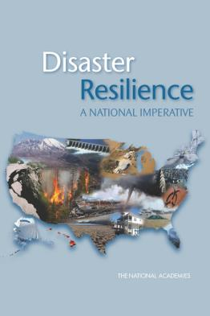
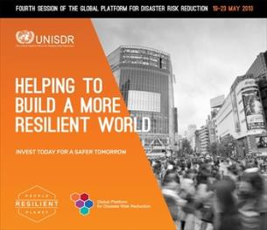
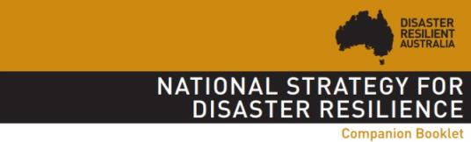
NATURAL DISASTER RESILIENCY
Role of Public sector:
Governments have an obligation to protect their citizens.
  National Strategies
  A combination of measures to ensure safety
  Disaster risk management framework
  Coordinating resiliency efforts
  Local Recovery Ordinance (Ken Toping, APA):
    A legal authority for post-disaster interventions to modify future development.

Slide 35
NATURAL DISASTER RESILIENCY
Role of Public sector: Planning and Planners’ roles (American Planning Association)
“Planners are an essential part of disaster recovery” “The role of planner in shaping the lens of recovery is (equally) important” (APA)
Planners must provide:
  Vision and strategic intent
  Opportunity and hope
  Adaptation and empathy
  Strong implementation and results
Planning Differences in a Post-disaster planning environment:
  Time compression
  Speed versus deliberation
  Modifying and tailoring the recovery specifics
  The type of disaster
  Scale and scope of disaster
  Assessment of physical damage to structure and infrastructure
  Psychological/emotional affects to the population
  Demographic and special needs populations

Slide 36

NATURAL DISASTER RESILIENCY
Role of Private sector:
Multinationals and international foundations are recognizing the importance of resiliency and are putting efforts in.
Technology companies: innovative technologies to improve resiliency of operating systems
Energy companies: diversifying energy sources
Public-Private Partnerships: are also integral in achieving resilience, as they can increase efficiency and effectiveness in the case of natural disaster.
Role of Academia and Institutions:
Provision of ongoing research and extensive knowledge to inform policymaking and planning strategies.
Academic Network for Disaster Resilience to Optimise Educational Development (ANDROID) – set up by the European Union

Slide 37


NATURAL DISASTER RESILIENCY
Role of Community (incl. NGOs):
Community has the most important role in resiliency; a prepared and knowledgeable community will stand strong in face of calamity.
Post-disaster recovery is often be from the ground up and the community needs to be prepared for this.
“Instead of repeated damage and continual demands for federal disaster assistance, resilient communities proactively protect themselves against hazards, build self-sufficiency and become more sustainable.” (Godschalk et al, 1009, in APA Presentation)

Slide 38
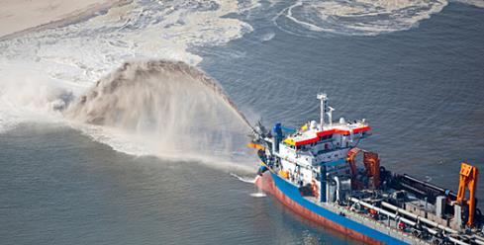
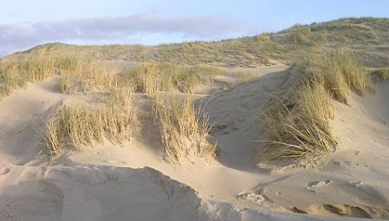
RESILIENCY MODELS
The Dutch Coast: environmental and infrastructural resilience
  Low lying country, some part 6m below sea-level – vulnerable and susceptible to rising sea levels.
  Importance of natural conservation in coastal defense.
    Protecting the coast against coastal erosion and implementing sand nourishment strategies.
    Conserving dunes

Slide 39
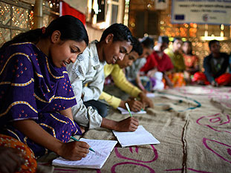
RESILIENCY MODELS
Bangladesh: community resilience
  Vulnerable to a range of natural disasters: typhoons, storm surges, rising sea levels, flooding
  High risk especially for populations at the coast.
  Importance of community disaster preparedness and awareness for disaster risk reduction:
    Early warning systems
    Disaster awareness and emergency response integrated into education at all ages.
    Awareness of evacuation procedures
    Civilian training
  Disaster preparedness measures have saved countless of lives.

Slide 40
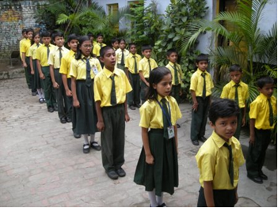
RESILIENCY MODELS
Odisha, India: community resilience
  Demonstrates the importance of increasing community resilience through education and awareness.
  10,000 college students are being trained: “About 42% of our population is in the 13 to 35 age group. Younger people can play an important role in disaster management. They are our strength,” (Patnaik, Urban News Digest)
  In 2013, 1 million people were evacuated and 28 casualties during a hurricane. This is a fraction of the 10,000 casualties in the hurricane that hit in 1999.

Slide 41

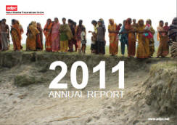
RESILIENCY MODELS
Asian Disaster Awareness Network
  Building up community resiliency and disaster awareness regionally:
    " Safer communities and sustainable development through disaster risk reduction “
  Organize training and programmes for disaster awareness and preparedness across Asia and the Pacific.
  Help with formulating country’s policies and developing their capabilities in all aspects of disaster management.
  Importance of awareness and the regional sharing of information – natural disasters are often at regional scale

Slide 42
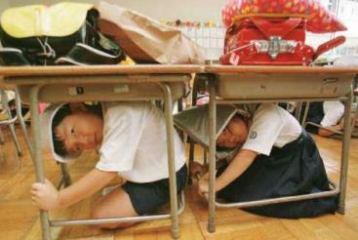
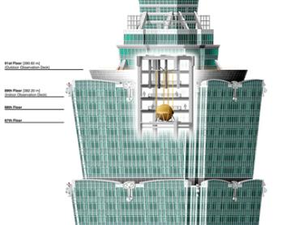
RESILIENCY MODELS
Tokyo: infrastructural and community resiliency
  Tokyo, and the rest of Japan, is often hit by earthquakes and tsunamis.
  A major focus on infrastructural resiliency and community preparedness.
    Building earthquake resistant buildings; retrofitting buildings to ‘sway’
    Providing more open spaces in the city for evacuation
    Early warning systems for earthquakes and tsunamis
    Civilian training

Slide 43
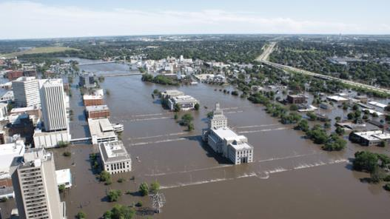
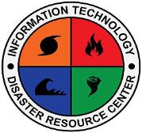
RESILIENCY MODELS
Cedar Rapids, USA (APA): community resilience in long-term disaster recovery
  Flood in 2008, from June 8th to July 1st.
  7 billion USD disaster
  10 sq miles (14%) of city impacted
  18,000 residents displaced
  310 city facilities flooded
Sense of community strengthened during and after the flood. (DeMond, 2010), in what was a socially stratified city before.’
After 2008: many events for disaster and community resilience:
  “The Symposium on Affordable Housing and Disaster Resilience” – Cedar Rapids. 2011
  “Building Disaster Resilient Communities” – Cedar Rapids

Slide 44
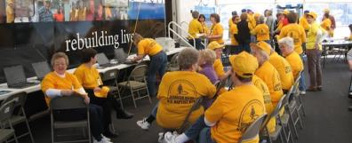

RESILIENCY PRINCIPLES
AWARENESS + EDUCATION
Knowledge is power, and in the case of a natural disaster it can be lifesaving. Awareness of disaster risk, preparedness and evacuation procedures heightens overall urban resilience against natural disasters.

Slide 45

RESILIENCY PRINCIPLES
GLOCALIZATION
Enabling cities to build up a sustainable ‘local’ economic base, while at the same time operating in the ‘global’ financial network. This entails working with an appropriate ‘global-local (glocal)’ relationship where global adds value to local and vice-versa.

Slide 46
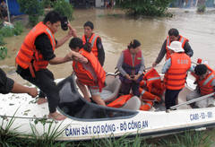
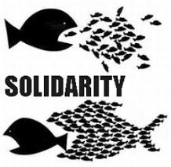
RESILIENCY PRINCIPLES
SOCIAL DIVERSITY + INTEGRATION
There is a need to mitigate social segregation in our cities.
Social diversity could be an asset only when there are opportunities for interaction and mixing of different sections of society.
Solidarity, cooperation and non-discrimination is pertinent for a strong and resilient community.

Slide 47
RESILIENCY PRINCIPLES
STRATEGIC VISION + DECENTRALIZATION
Bottom-up civic governance: decentralizing and spreading responsibility and accountability to district and municipality level.
Modern-day digital network technology is an opportunity to empower the ordinary citizen with decentralized access to services, governance and information. For instance, the concept of centralized governance could be replaced by decentralized local governance working as part of a coherent holistic vision.

Slide 48



RESILIENCY PRINCIPLES
‘RECYCLING’ (OF SPACE AND RESOURCES)
21st century cities are dealing with unprecedented rates of urbanization and shortage of resources. Spaces need to be equipped with flexibility to accommodate multiple uses, to help reduce spatial junk.
Resources- water, energy, material; need to be recycled. Thus ‘recycling’ should become an underlying philosophy for urban resilience.

Slide 49

RESILIENCY PRINCIPLES
SYSTEMS DIVERSITY + REDUNDANCY
Overlapping functions and system redundancy reduces efficiency, but it increases resilience. Redundancy means if one system fails, chances of disruption are lower as another system can take over.

Slide 50
RESILIENCY PRINCIPLES
MOBILITY + FLEXIBILITY
Being connected and enhancing mobility become key before, after and in the longer term as well.
By being flexible, a city can be more adaptive during hardship and more easily overcome problematic situations. Diversity and recycling of spaces and resources adds to a city’s flexibility.

Slide 51


RESILIENCY PRINCIPLES
RESILIENCE TO CLIMATE CHANGE
The growing population pressure on cities and urban sprawl means there is a greater risk of exposure to natural disasters. Better organization of local community structure could again be a step to help in urban resilience to climate change.

Slide 52


RESILIENCY PRINCIPLES
ECOSYSTEM SERVICES
Resilient systems recognises and values the services of the environment, reducing the risk of ‘externalities’ and maintaining environmental accountability.

Slide 53

RESILIENCY PRINCIPLES
INNOVATION
Learning and trying new things is vital to adaptation when change comes. Resilience calls for ongoing learning and the freedom to experiment.

Slide 54



RESILIENCY PRINCIPLES
MONITORING + MEASURING
Continuous testing that the systems in place actually work, and monitoring natural events that can inform early warning systems.

Slide 55
CREATING RESILIENT + LIVABLE CITIES
A common vision and strong leadership
Work with people and nature
Be prepared
Restore human dignity
Build resilient and sustainable communities
Be aware and educated
Be connected and networked
Work together
Get engaged

