Slide 1
Office of the Presidential Assistant for Rehabilitation and Recovery
Pacific Cities Sustainability Initiative Second Annual Forum

Slide 2
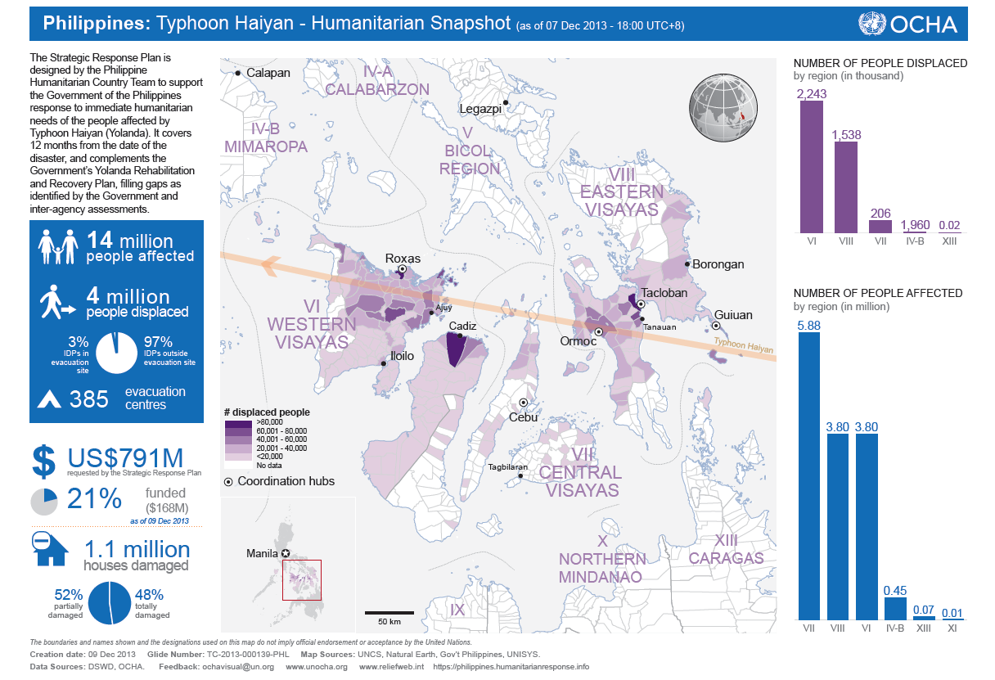
  Typhoon Yolanda left a trail of destruction across Central Philippines
SOURCE: OCHA

Slide 3
Initial estimates from RAY show that rehabilitation will be an unprecedented challenge – requiring the support of all stakeholders
Recovery and reconstruction funds needed
US$ billion
On-budget
Housing
1.7
2.5
4.1
Off-budget ("gap")
Industry & services
0.1
1.5
1.6
Education
0.3
0.7
0.4
To be updated in coordination with NDRMMC, NEDA and line agencies
Agriculture
0.2
0.4
Social protection
0.3
0.4
Roads and water
0.2
0.2
Electricity
0.1
0.2
Transport
0.2
Health
0.2
Local government
0.1
Total
2.8
5.3
8.2
SOURCE: NEDA RAY report Dec 2013
Notes:
As we already know, the scale of the tragedy is huge. We need PHP 360 Bn to rebuild the affected areas.
So far, only a small percentage has been allocated by the government – even though most of the damaged property is privately-owned.

Slide 4

  MO No. 62 establishes PARR to manage and coordinate rehabilitation, recovery and reconstruction efforts
Role of Presidential Assistant for Rehabilitation and Recovery
  Act as the over-all manager and coordinator of rehabilitation, recovery and reconstruction efforts of government departments, agencies and instrumentalities in the affected areas.
  Included in these affected areas are Samar, Leyte, Negros, Cebu, Bohol, Capiz, Aklan, Antique, Iloilo and Palawan
  Coordinate with the National Disaster Risk Reduction and Management Council (NDRRMC) and its member-agencies and consult with the concerned local government units in the formulation of plans and programs for the rehabilitation, recovery and development of the affected areas.
  Propose funding support for the implementation of plans
  Exercise oversight over the relevant government agencies with respect to the implementation of the plans and programs
  Call upon any department, bureau, office, agency, or instrumentality of the government, including Government-Owned or Controlled Corporations (GOCCs), Government Financial Institutions (GFIS), LGUs, and request non-government organizations (NGOs), the private sector, and other entities for assistance as the circumstances and exigencies may require in carrying out his mandate.
  All departments, bureaus, offices, agencies, or instrumentalities of the government, including GOCCs and GFIs, are hereby directed to render full assistance and cooperation to the Presidential Assistant as may be required to carry out his functions pursuant to this Order. LGUs, NGOs, the private sector, and other entities for assistance as the exigencies may require

Slide 5


















Several leading companies have volunteered to serve as
Development Sponsors
AID
Province
District
Development Sponsor
AID
Province
District
Development Sponsor
1
Leyte
Tacloban 1
13
Samar
2nd District
2
Leyte
Tacloban 2
14
Cebu
3rd and 5th Districts
3
Leyte
Palo
15
Cebu
4th District
4
Leyte
Rest of 1st District
16
Negros Occ.
1st, 2nd & 3rd Districts
5
Leyte
2nd District
17
Aklan
Lone District
6
Leyte
3rd District
18
Antique
Lone District
7
Leyte
Ormoc/Kananga
*
19
Capiz
1st District
8
Leyte
Rest of 4th District
20
Capiz
2nd District
9
Leyte
5th District
21
Iloilo
2nd and 3rd District
10
Biliran
Lone District
22
Iloilo
4th District
11
E. Samar
Guiuan/Salcedo
23
Iloilo
5th District
12
E. Samar
Rest of Lone District
24
Palawan
1st District
Notes:
We are nearly complete in identifying development sponsors

Slide 6
OPARR is forming clusters to facilitate the consolidation of the plans and programs of the various stakeholders (1/2)
Objective
Member agencies
Infrastruc-ture
  All infrastructural-related rehabilitation
  Construction, repair, and restoration of damaged roads, bridges, and other public infrastructure
  DPWH
  DepEd
  DOE
  DENR
  DTI
  LWUA
  DOH
  DOST
  DOTC
  DILG
  OCD
Other stakeholders will be consulted in this process
  Multilaterals/bi-laterals
  LGUs
  Private sector
  Civil society organizations
Resettle-ment
  Relocation of affected residents of safe areas and for the development of secure, comprehensive, and sustainable settlements
  Construction of off-site totally damaged houses
  DILG
  DA
  DAR
  DepEd
  OCD
  HLURB
  HUDCC
  DENR
  DOH
  DOST
  DSWD
  NCIP
  NHA
Social services
  Relief operations and community services
  Food, health, education, and emergency shelter assistance and core shelter assistance
  DSWD
  DND
  DA
  DepEd
  NHA
  OCD
  DENR
  DoH
  PNP
  HLURB
  HUDCC
  NCIP
SOURCE: Source

Slide 7
OPARR is forming clusters to facilitate the consolidation of the plans and programs of the various stakeholders (2/2)
Objective
Member agencies
Liveli-hood
  Provision of livelihood and emergency employment assistance to affected families
  Crop production and industry and trade services, forestry, fishery, and livestock & poultry industries
  DTI
  DOLE
  DOT
  DA
  DENR
  OCD
  DOST
  DSWD
  HUDCC
  NCIP
  NHA
  GFIs may be invited
Other stakeholders will be consulted in this process
  Multilaterals/bi-laterals
  LGUs
  Private sector
  Civil society organizations
Support
  Consolidating the vetted cluster action plans
  Identification and provision of funding support to the major programs & projects
  DBM
  DFA
  DoF
  DoJ
  DSWD
  PMS
  NEDA
  OCD
  OPAPP
  PCDSPO
  PCOO

