Slide 1
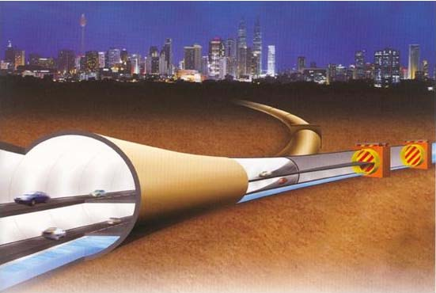
The Stormwater Management
and Road Tunnel of Malaysia
Presented by:
Dato Ir. Lim Chow Hock
Department of Irrigation and Drainage Malaysia
12 March 2014 Manila
Notes:
1

Slide 2
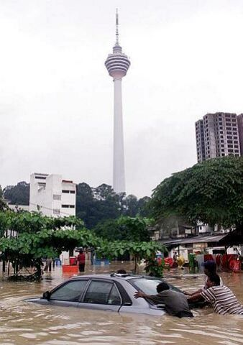
SMART – Project Objectives
To provide a stormwater management system to reduce flooding at the Kuala Lumpur city centre due to stormwater from the Klang-Ampang sub-catchment
To reduce traffic congestion at the southern main gateway (near TUDM Sg. Besi) to the city centre

Slide 3
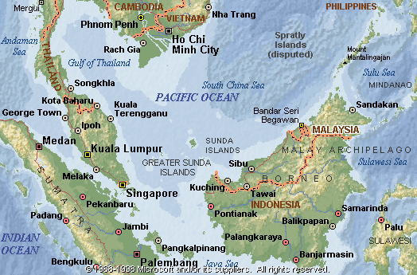
Climate – Annual rainfall 3000mm; Temperature 21º – 32º C; Relative humidity 80%; Open water evaporation 1600 -1800 m

Slide 4
Types of Floods
2 types of floods:
  Monsoonal flood
    caused by long duration, moderate to high intensity rainfall
    widespread and long duration flooding (1-4 days)
    riverbank overflow
  Flash flood
    caused by short duration and high intensity rainfall
    Highly localised, short duration (2-3 hours)

Slide 5
Planning the SMART
Factors against traditional solutions
  Land acquisition cost is too expensive
  River reserves not sufficient to widen channel
  Dam construction – brings complex social and environment issues
  Human displacement
Climate change pressure
  Rainfall intensity increasing, flash flood more frequent
  Close to 100 year ARI rainfall events increasing in city area
Costs of restoration
  Flood damage can cripple economy
  Socio-political threat
Tunnel motorway can help reduce traffic congestion
  Southern gateway into city center heavily congested
  Offers added value to tunnel investment
  Unique solution to two major problems

Slide 6
KL Flood Mitigation Program
CONCEPT 1: DIVERSION AND DETENTION OF FLOOD WATERS
  Gombak River Catchment – retard flow
    divert part of Gombak River stormwaters to detention ponds
    Construct Gombak flood diversion channel
  Keroh River – divert flow
    Divert flood flow to detention ponds
    Construct Keruh flood diversion channel
CONCEPT 2: DIVERSION AND BYPASS
  Klang River Catchment
    At confluence of Klang & Ampang Rivers, divert flow from city center
    Construct SMART
    Bypass city center and discharge into pond downstream of city center and into Klang river system

Slide 7
BATU DAM
KLANG
GATES DAM
(36.6 mcm)
(25.1 mcm)
CONTRACT 2
Keroh River Diversion
(2.2 km)
CONTRACT 2
Gombak River Diversion (3.375 km)
290 cumec
30 cumec
80 cumec
Sg Batu
150 cumec
275 cumec
Kolam Takungan Jinjang
Sg Klang
Kolam Takungan Batu
(2.5 mcm)
(4.5 mcm)
Sg Gombak
100 cumec
100 cumec
190 cumec
125 cumec
35 cumec
35 cumec
45 cumec
Sg Keroh
Sg Jinjang
Kolam Kg Puah
10 cumec
Sg Bunus
Kolam Kg Berembang (0.6 mcm)
Kolam Kg Benteng
(0.4 mcm)
65 cumec
280 cumec
Sg Gombak
CONTRACT 1
SMART Bypass Tunnel
(9.7 km)
PWTC
Masjid Jamek
Sg Klang
FLOOD PRONE
AREA
400 cumec
180 cumec
Sg Kerayong
300 cumec
Kolam Taman Desa
(1.4 mcm)
NOT TO SCALE

Slide 8
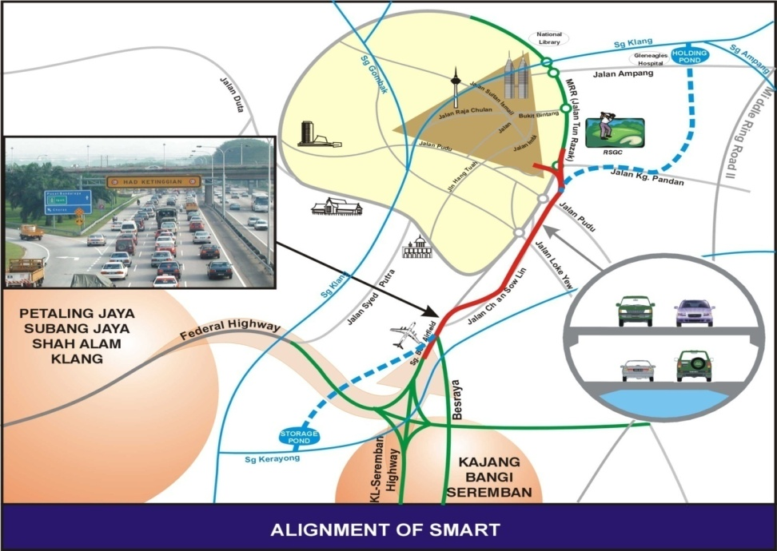
The tunnel alignment

Slide 9
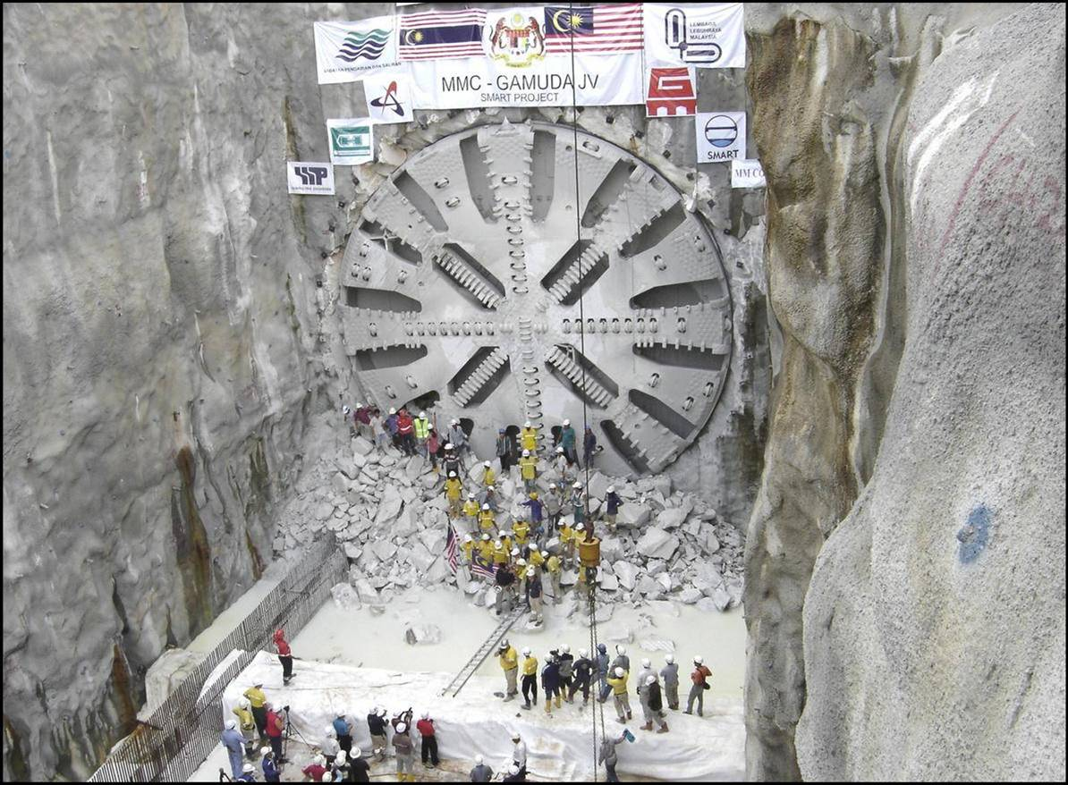
SMART – tunneled through karstic limestone and unconsolidated alluvium
Making the breakthrough on 11 December 2004

Slide 10
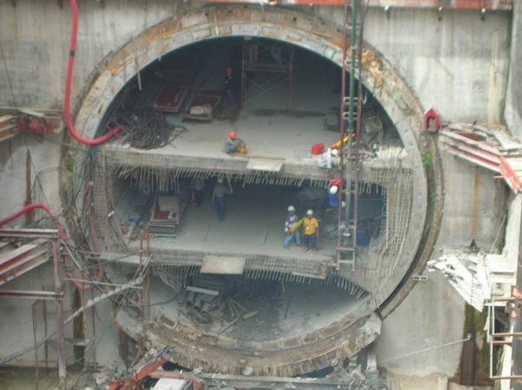
ROAD TUNNEL CROSS SECTION
SMART – dual deck design was the first of its kind

Slide 11
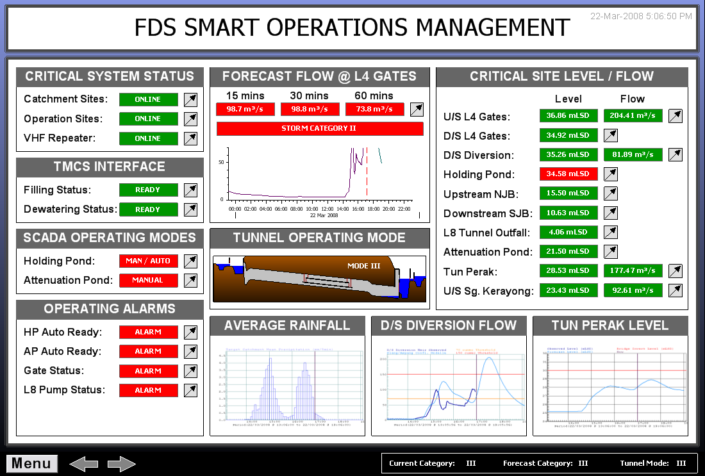
The SMART’s Brain:
The Flood Detection System

Slide 12
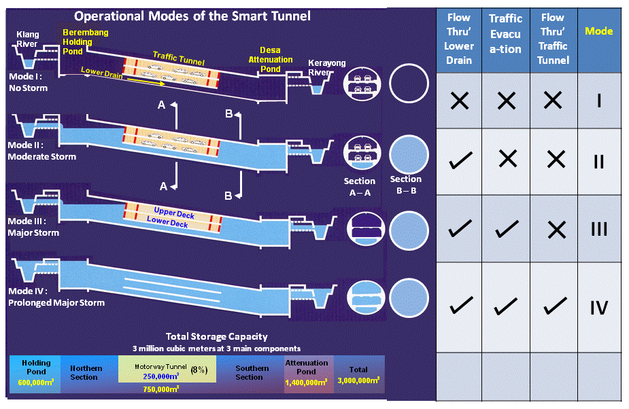
SMART’s 4 Operational Modes
Flow (cumec)
Operation of SMART Stormwater System
< 70
1
70-150
2
> 150
3
Traffic evacuation = 1 hour
> 150 prolong
4
Lower drain = 70 m3/ s

Slide 13
Event Statistics – 228 diversion events since 2007
YEAR | MODE 2 | MODE 3 | MODE 4 | TOTAL
2007 | 13 | 2 | 0 | 15
2008 | 30 | 21 | 1 | 52
2009 | 21 | 13 | 0 | 34
2010 | 11 | 14 | 0 | 25
2011 | 21 | 19 | 1 | 41
2012 | 26 | 8 | 3 | 37
2013 | 18 | 2 | 0 | 24*
TOTAL | 140 | 79 | 5 | 228
Mode 4 on the 4/9/2008 , 21/5/2011, 7/3/2012 , 2/5/2012 and 26/11/2012
* Mode 2B on the 10/4/2013, 14/4/2013, 7/5/2013 and 10/10/2013

Slide 14
Final Notes
Major floods averted 5 times
March 7, 2012 – largest storm event since SMART existed
  237 mm rainfall in 5 hours in Ampang catchment – exceeds 100 yr ARI
  150 mm rainfall in Klang catchment – near or close to 100 yr ARI
  Klang River at city center overtopped by 15 cm for 27 minutes
  3.3 mil. cu/ meters successfully diverted
SMART has successfully performed under design storm situation
Floods can still occur. SMART plays a specific role and not a total solution.

Slide 15
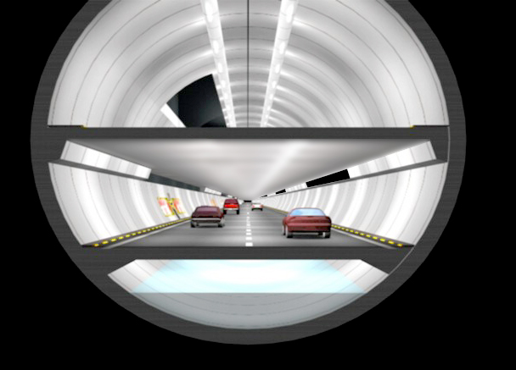
T e r i m a K a s i h
T h a n k Y o u
April
2005
Notes:
15

