Slide 1
Pacific Cities Sustainability Initiative – Second Annual Forum Session 4: Public-Private Partnerships Case Studies
The Port City of Aqaba, Jordan Low-Income Housing, India
Jim O’Gara, Director
Deloitte Transactions and Business Analytics, LLP
March 12, 2014

Slide 2
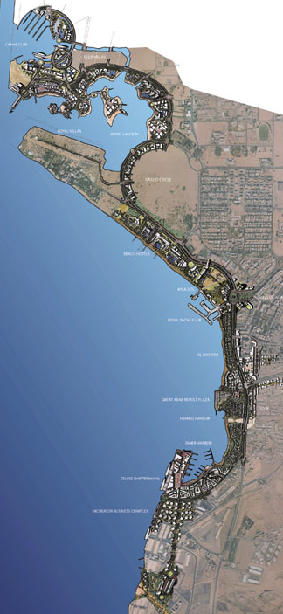
The Port City of Aqaba, Jordan
Success through a concerted effort and flexibility in turbulent times
Concept
Under-performing and under-utilized assets in Jordan’s only port city
Entire city and surroundings (375 km²) was granted special economic zone (SEZ) status
A special model for private participation in all aspects of port city development, including appointment of a Master Developer (Aqaba Development Corporation)
High-quality urban plan unlocked the potential of Aqaba as both a tourism and industrial hub
30,000 jobs
Increased trade and port activity
Story
Results
September 11, 2001: eight months after launch of SEZ, followed by invasion of Iraq (Aqaba’s biggest customer)
Master Developer Concept was adjusted to account for new business environment, unbundling into less risky transactions
Several pilot transactions restored confidence to the market
Aqaba re-positioned as a regional real estate and tourism investment opportunity given oil-driven wealth creation
US $20 billion in committed
investment

Slide 3
Low-Income Housing, India
Bringing market-based solutions to base-of-the-pyramid needs
Low-income Households
Government
Private Developers
Mortgage Finance Firms
Monthly household income US$280-340
Most live in poorly constructed housing with subpar sanitary conditions
Able to afford 35% of income on rent
Recognizes housing problem, but hands are tied with equally pressing issues in other sectors
Insufficient resources to properly address issue
Cannot see opportunity to serve low-income consumers without impacting profitability
“There are more attractive segments to serve”
Views the low-income segment as “risky” and “high cost” to serve
Public
Private
Est. US$220 billion market size
Est. 22 million low-income households
Quality affordable housing in short supply

Slide 4
Market-Making Approach and Outcomes
2005
2006
2007
2008
2009
2010
2011
2012
Building the Supply of Housing
Re-Shaping the Finance Market
Growing the Ecosystem
Building the Supply of Housing
Developed new business model “leveraging aggregated formal sector demand”
Validated the model thru pilot projects
Scaled supply by raising awareness and working with corporates to drive scale in supply of affordable housing units
Successfully created market for low-income customers
Over 50,000 homes built across 13 cities by 30 developers
Re-Shaping the Finance Market
Catalyzed the housing finance sector to approach the informal sector
Incubated first housing finance company (HFC) serving low-income customers
Built strategy and team for new HFC
Delivered Outcomes
At least 10 Mortgage Finance Companies serving the market
Growing the Ecosystem
Multiple stakeholders were convened to strengthen public-private collaboration
Raising awareness of the opportunity and model

Slide 5
About Deloitte Deloitte refers to one or more of Deloitte Touche Tohmatsu Limited, a UK private company limited by guarantee, and its network of member firms, each of which is a legally separate and independent entity. Please see www.deloitte.com/about for a detailed description of the legal structure of Deloitte Touche Tohmatsu Limited and its member firms. Please see www.deloitte.com/us/about for a detailed description of the legal structure of Deloitte LLP and its subsidiaries. . Certain services may not be available to attest clients under the rules and regulations of public accounting. Copyright © 2014 Deloitte Development LLC. All rights reserved. Member of Deloitte Touche Tohmatsu
Notes:
5

